Slide 1
Progress Report
Zero-sum stochastic game – Light against zombies
Eliav shalelashvili

Slide 2
Table of contents
Game Environment – The Problem of Light Against Zombies
Framework Implementation
Learning Agents
Game Scenarios
Game Evaluation

Slide 3
Research goal
Build learning agents to play the game of Light against Zombies
Notes:
בניית שחקנים לומדים במשחק האור והזומבים

Slide 4
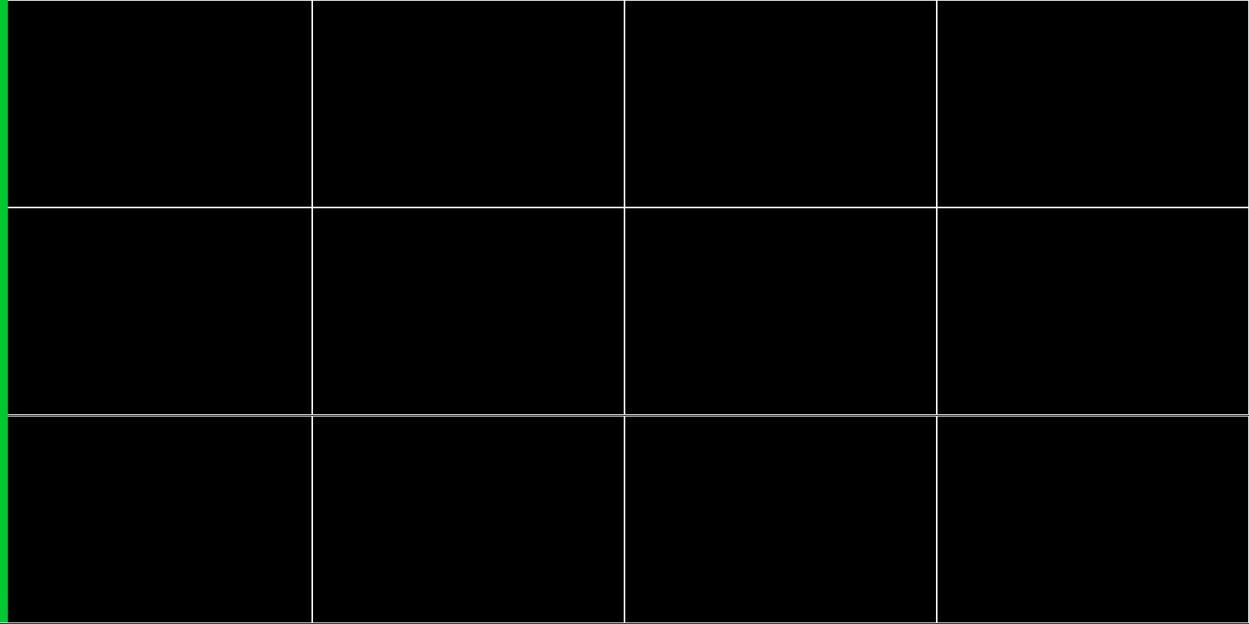

Game Environment
Board of $N×N$ cells
State space
Zombie Player - zombies’ positions
Light Player - zombies’ positions and hit points
Action space
Zombie Player – starting position* for a new zombie, total of $N$ possible actions
Light Player - light position on the board, total of $N×N$ possible actions

Slide 5
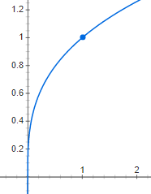

Environment characteristics
Reward function
Opposite reward
Zombie player receives +1 reward for every zombie that passes the end safely
At every time-step, All zombies are healed with a constant value of Heal-Points
What do we mean by “safely”?
Every zombie has an attribute called Hit-Points
A zombie, with a Hit-Points value of $"h"$, passes the right border safely under terms:
$\left\{\begin{aligned}h<max⁡_hit_points \\ \sqrt[3]{\frac{h}{max⁡_hit_points}}<Random\left(0,1\right)\end{aligned}\right.$

Slide 6
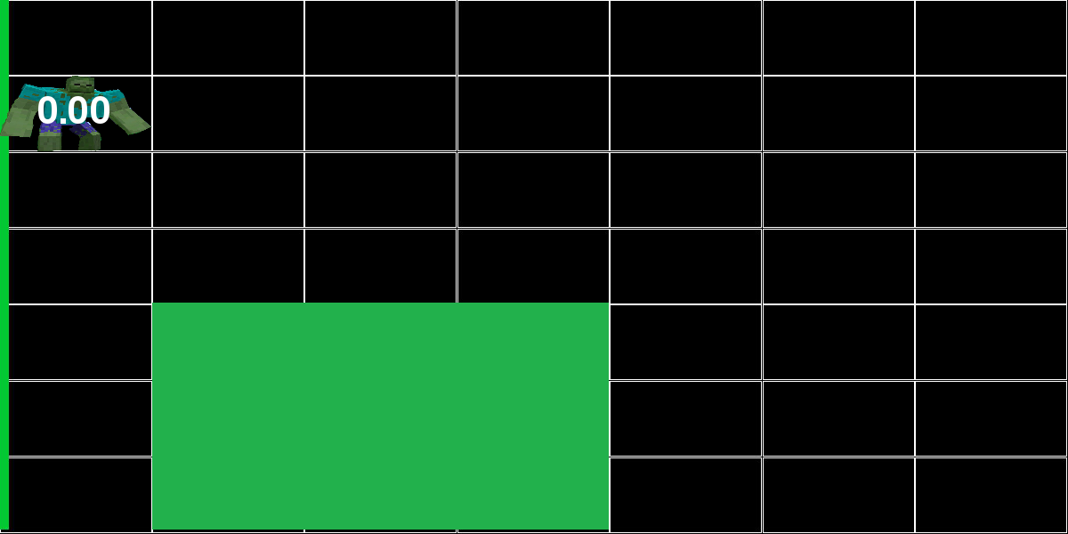
Example – 1st frame
Zombie reward: 0
Light reward: 0
Notes:
Light size of 2x2

Slide 7
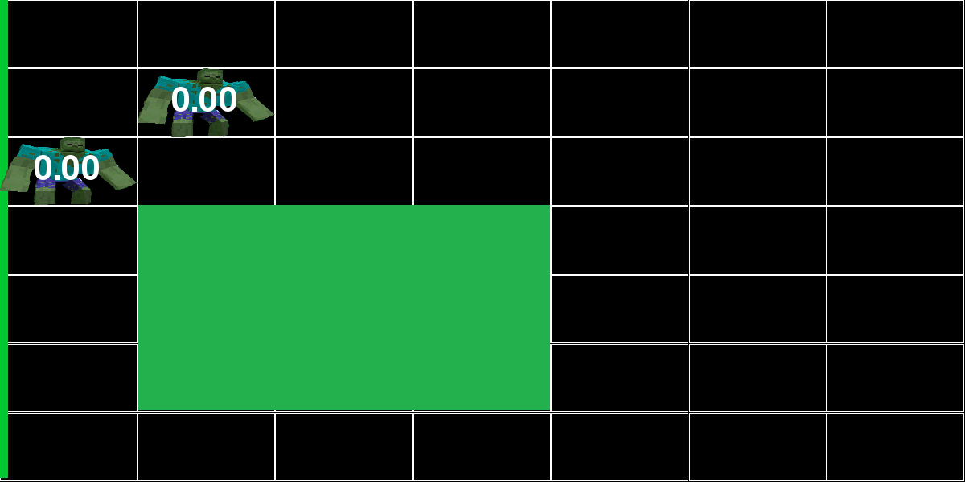
Example – second frame of the game
Zombie reward: 0
Light reward: 0

Slide 8
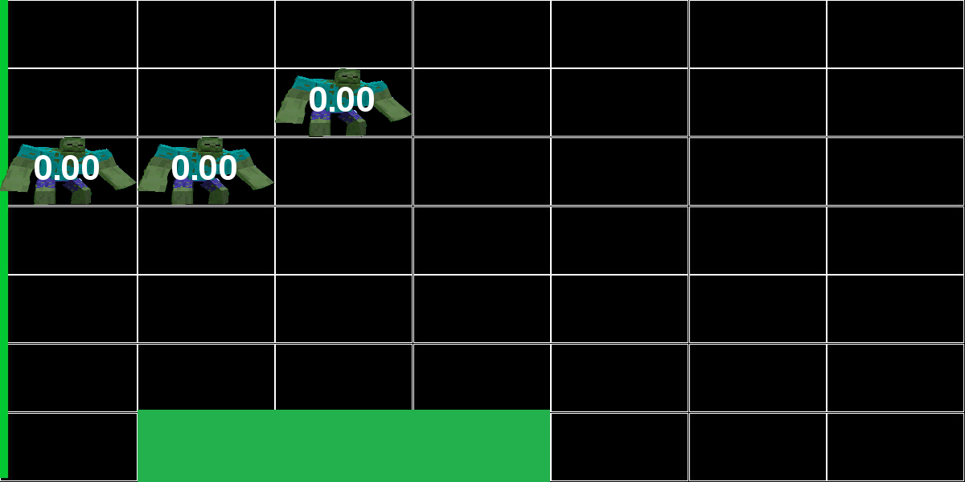
Example – third frame of the game
Zombie reward: 0
Light reward: 0

Slide 9
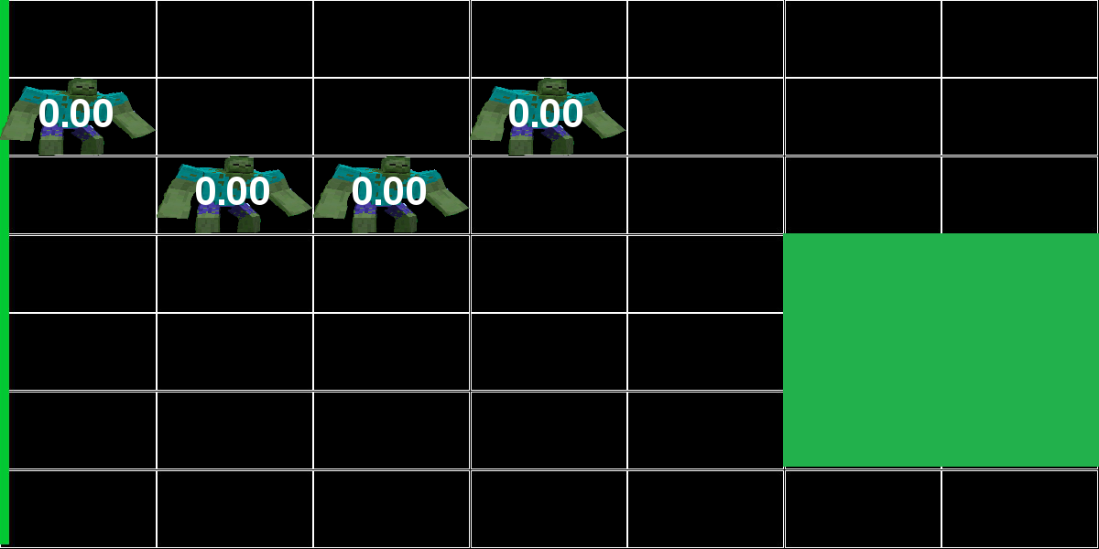
Example – forth frame of the game
Zombie reward: 0
Light reward: 0

Slide 10
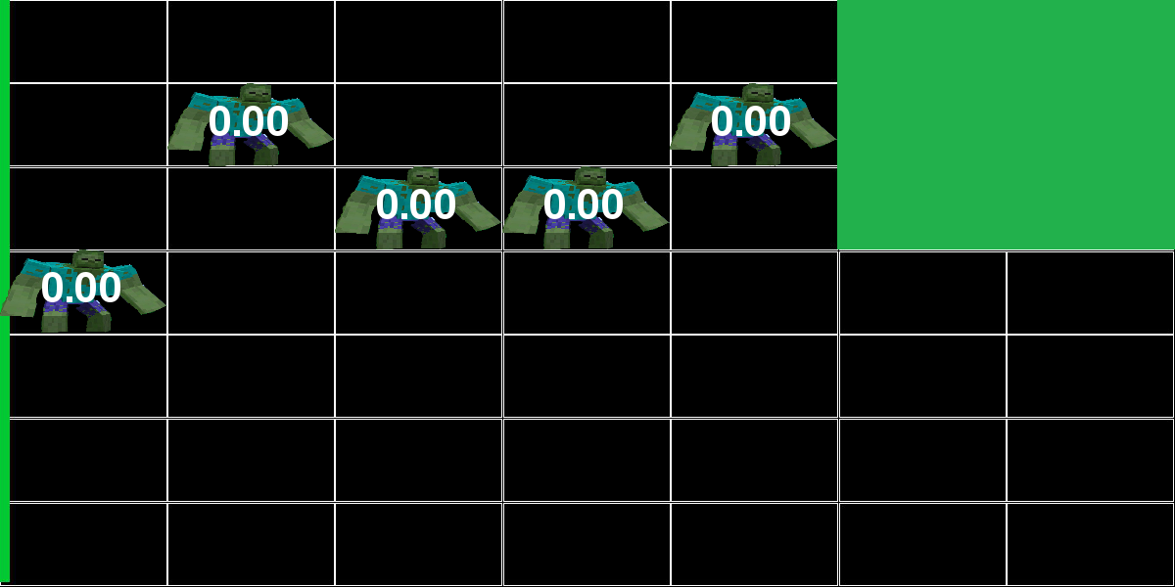
Example – fifth frame of the game
Zombie reward: 0
Light reward: 0

Slide 11
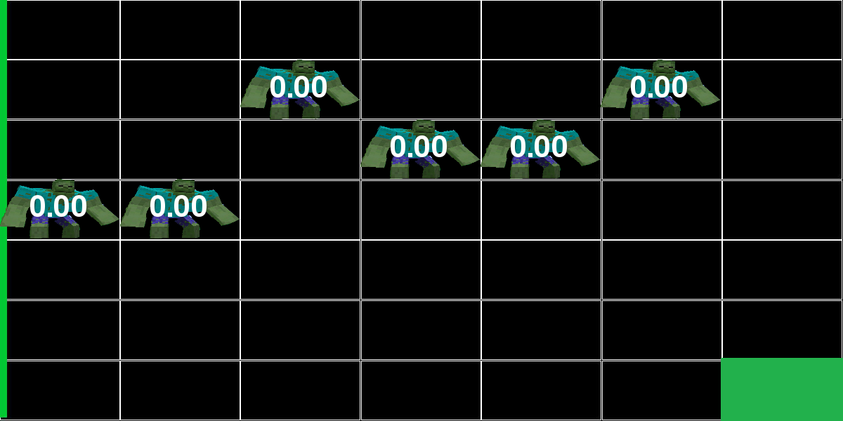
Example – sixth frame of the game
Zombie reward: 0
Light reward: 0

Slide 12
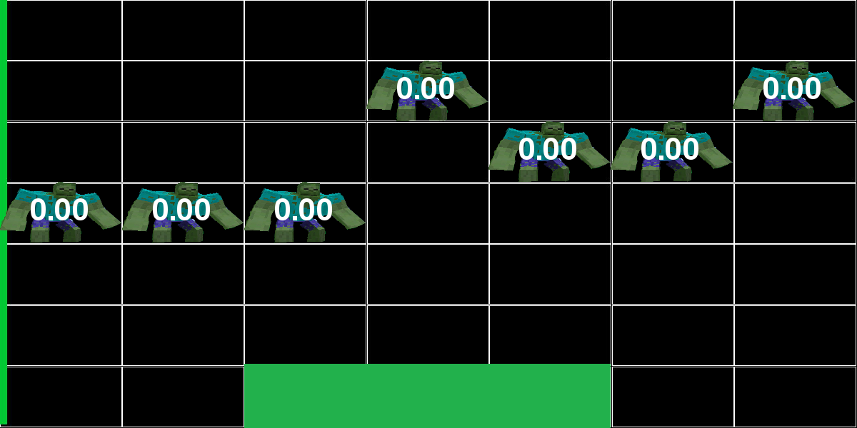
Example – 7th frame
Zombie reward: 0
Light reward: 0

Slide 13
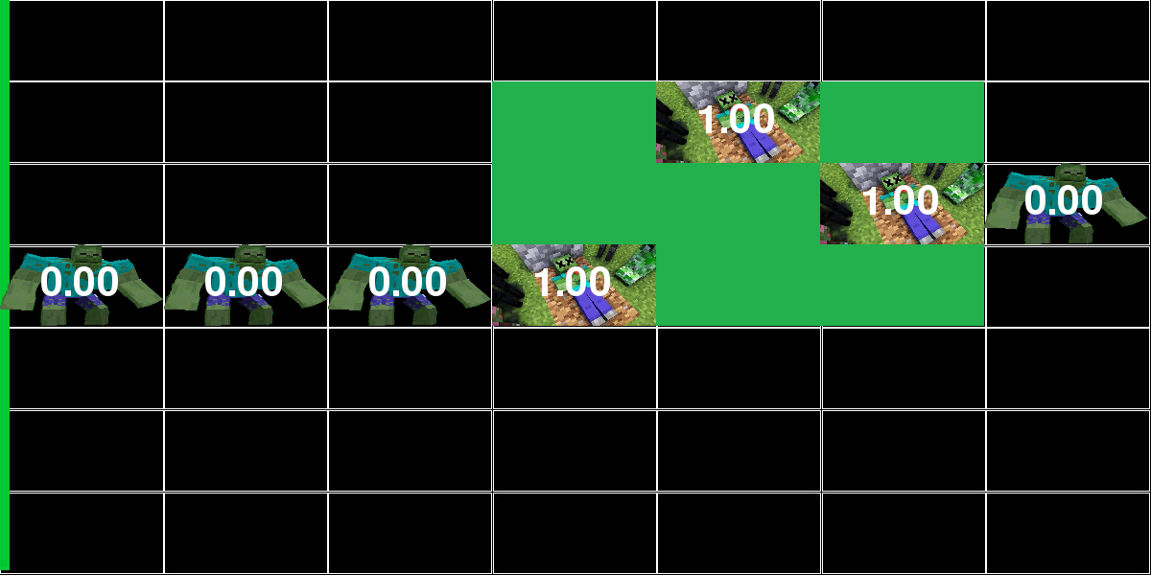
Example – 8th frame
Zombie reward: 1
Light reward: -1

Slide 14
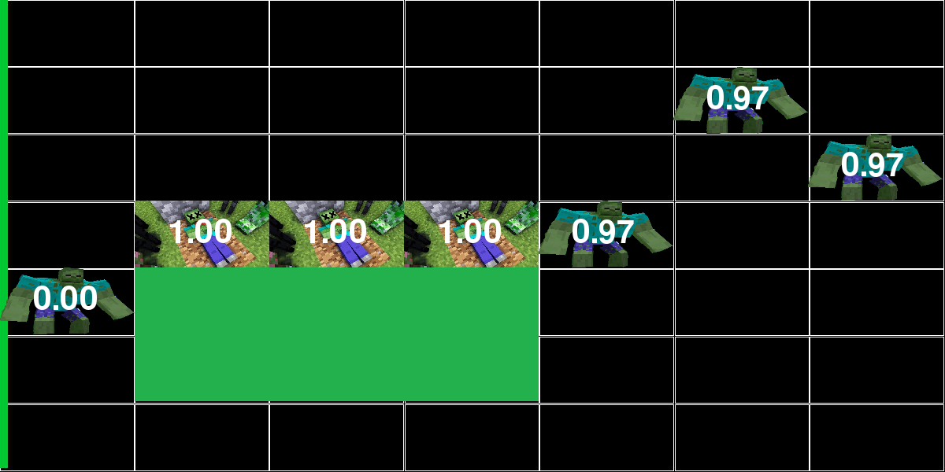
Example – 9th frame
Zombie reward: 1
Light reward: -1

Slide 15
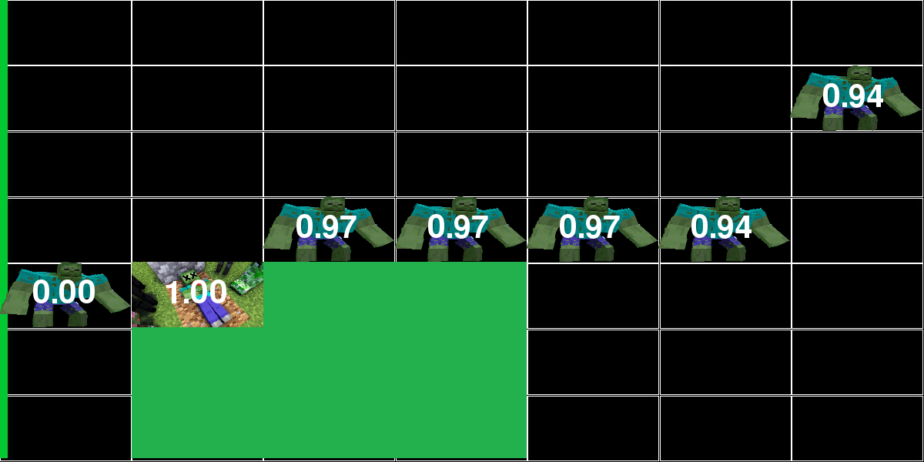
Example – 10th frame
Zombie reward: 0
Light reward: 0

Slide 16
Example – 11th frame
Zombie reward: 0
Light reward: 0

Slide 17
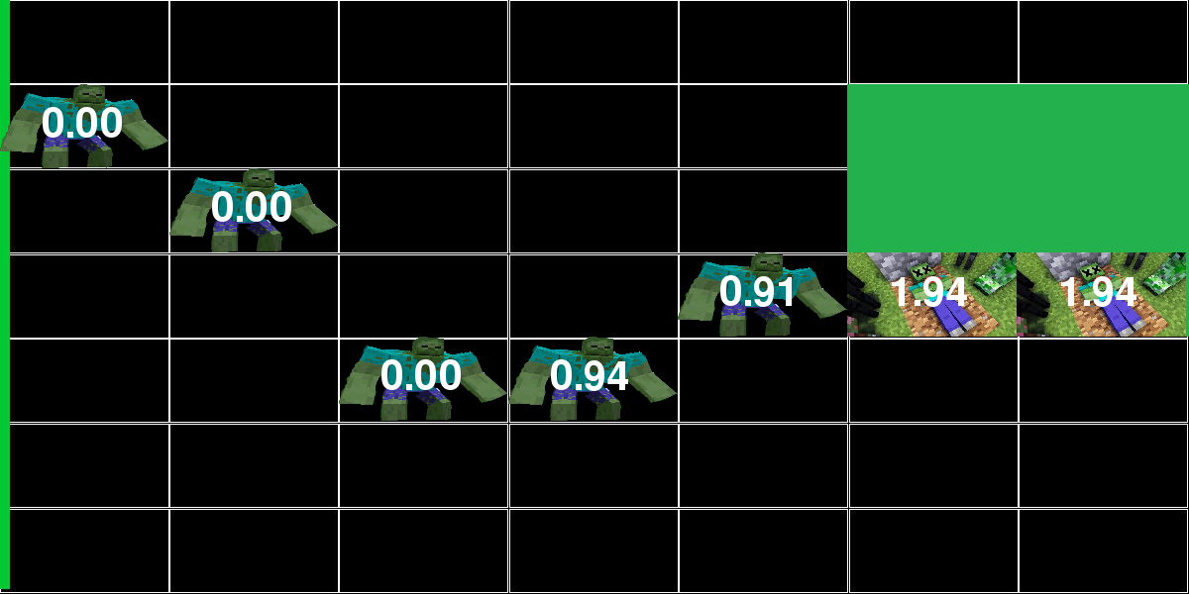
Example – 12th frame
Zombie reward: 0
Light reward: 0

Slide 18
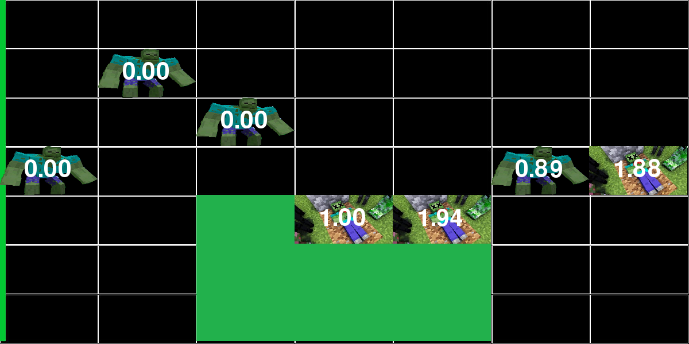
Example – 13th frame
Zombie reward: 0
Light reward: 0

Slide 19
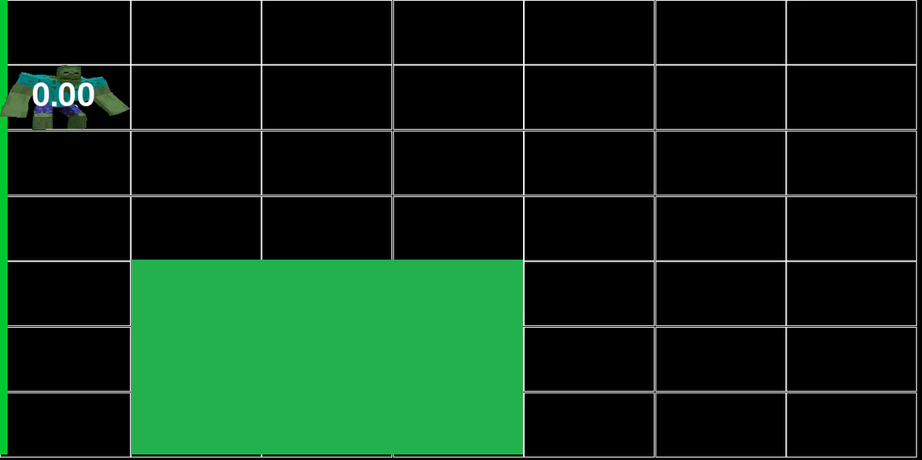
Game-play demonstration

Slide 20
Framework implementation
Building a framework that is able to communicate with an interface of generic type of any agent, turned to be an integrated and significant part of the project
We built a framework for developing and comparing reinforcement learning algorithms
More than 20 classes and interfaces
Four simple agents
A learning agent from the Reinforcement Learning domain
It currently contains the game of “Light against Zombie” and supports teaching agents as both players
Notes:
Before we diving deep into all the gameplay-scenarios, lets review the platform we have built to handle the project demands

Slide 21
running the framework
1. Define configuration:
Interactive mode - Boolean
Display width/height
Number of training and validation episodes
Number of zombies per episode
Light size
Board width/height
Maximum hit points
Heal ratio

Slide 22
running the framework
2. Competitors definition:
Each agent must implement some basic methods in order to participate the game:
Given a state, choose action
Learning by batches of (state, action, next state, reward)
Example:
Uniform distribution agent as the zombie player
Given a state, choosing action from uniform distribution
None
3. Run the scenario of two agents playing Light and Zombie

Slide 23
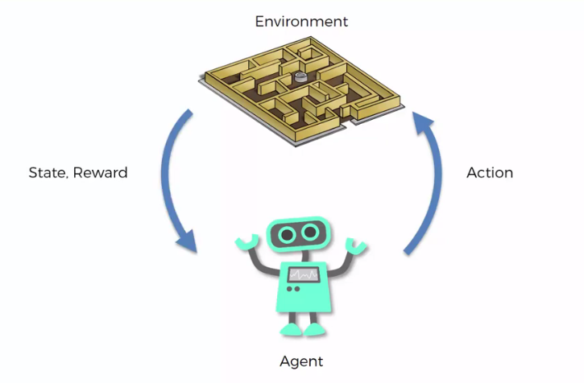


running the framework - summary
Preparations
1. Define agents and implement by abstract classes
2. Add configuration of agents and environment
Main Process
3. Run the game with two agents as light and zombie players
LIGHT
ZOMBIE

Slide 24

Games and agents
Squared Game Boards of: $10, 20, 30$
Simple Agents:
Single Action
Double Action
Uniform
Gaussian
Learning Agent:
Double Deep Q-Learning

Slide 25

Simple Agents elaboration
From a given set of N possible actions
Single Action - picks the first action
Double Action - picks the first and middle actions
Uniform Action - picks a uniformly action
Gaussian Action - picks an action from the normal distribution with:
Mean - middle action
Standard deviation - $\frac{N}{5}$

Slide 26
Double deep q-learning agent
Two networks:
Policy/online network
Target/offline network
At each learning step, backpropagate weights of online network with mean squared error loss of the target network

Slide 27

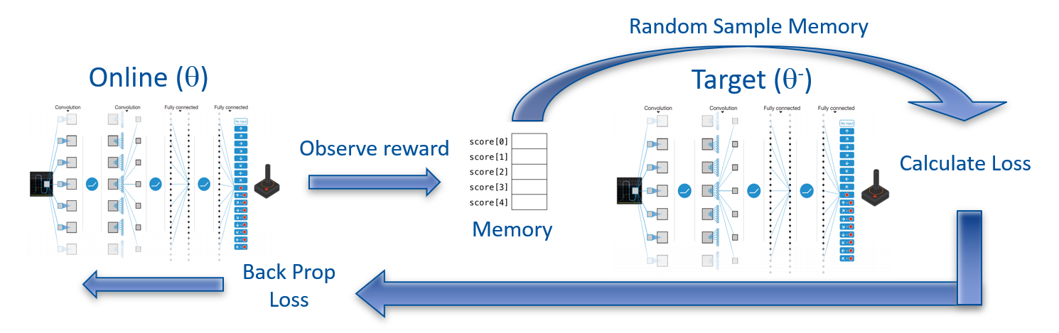
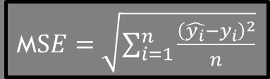


Game Environment
State
Double Deep Q-Learning Agent:
State
Back-prop
M$SE=\sqrt{\sum_{i=1}^{n}{\frac{{\left(\hat{y_{i}}−y_{i}\right)}^{2}}{n}}}$
Loss
$$\hat{y_{i}}= Target output$$
$$y_{i}= Online output$$

Slide 28
Game config
Fixed Parameters:
Number of training episodes: 800
Number of test episodes: 200
Zombies per episode: 20
Light size: 2*
Minimum hit points of certain death: 1
Heal ratio: 0.97
Tuning Parameters:
Target Policy update frequency – [500, 750, 1000]
Replay Memory size – [3000, 4000, 5000]

Slide 29
game scenarios
Zombie Player | Light Player | Game Board
Single Action | DDQN | 10x10
Double Action
Uniform
Gaussian
Single Action | DDQN | 20x20
Double Action
Uniform
Gaussian
Single Action | DDQN | 30x30
Double Action
Uniform
Gaussian
Zombie Player | Light Player | Game Board
DDQN | Single Action | 10x10
 | Double Action
 | Uniform
 | Gaussian
DDQN | Single Action | 20x20
 | Double Action
 | Uniform
 | Gaussian
DDQN | Single Action | 30x30
 | Double Action
 | Uniform
 | Gaussian

Slide 30
Double deep q-learning evaluation process
1. Estimate success of the DDQN agent by Average Test Score
2. Choose the best sets of parameters
3. Compare the results of the best agents over different boards

Slide 31
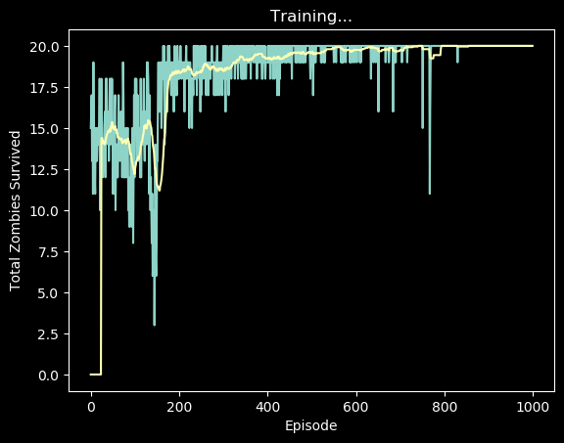
Example of a single evaluation
For each scenario (Ex. DDQN as Zombie and Single Action Agent as Light), the framework produces the following “Reward per episode” graph:

Slide 32

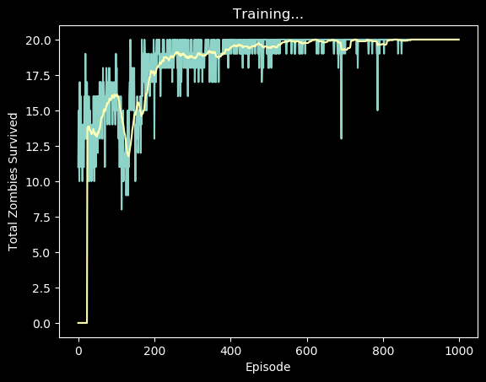



Example of a single evaluation
Considering the scenario of DDQN as Zombie vs. Single Action Agent as Light on top a board of $10×10$:
First, repeat the scenario several times
Second, get the average of test rewards
Average
$$−>$$
19.99

Slide 33
DDQN as the zombie player
Goal – Maximize Total Reward - Maximize Zombies survive

Slide 34
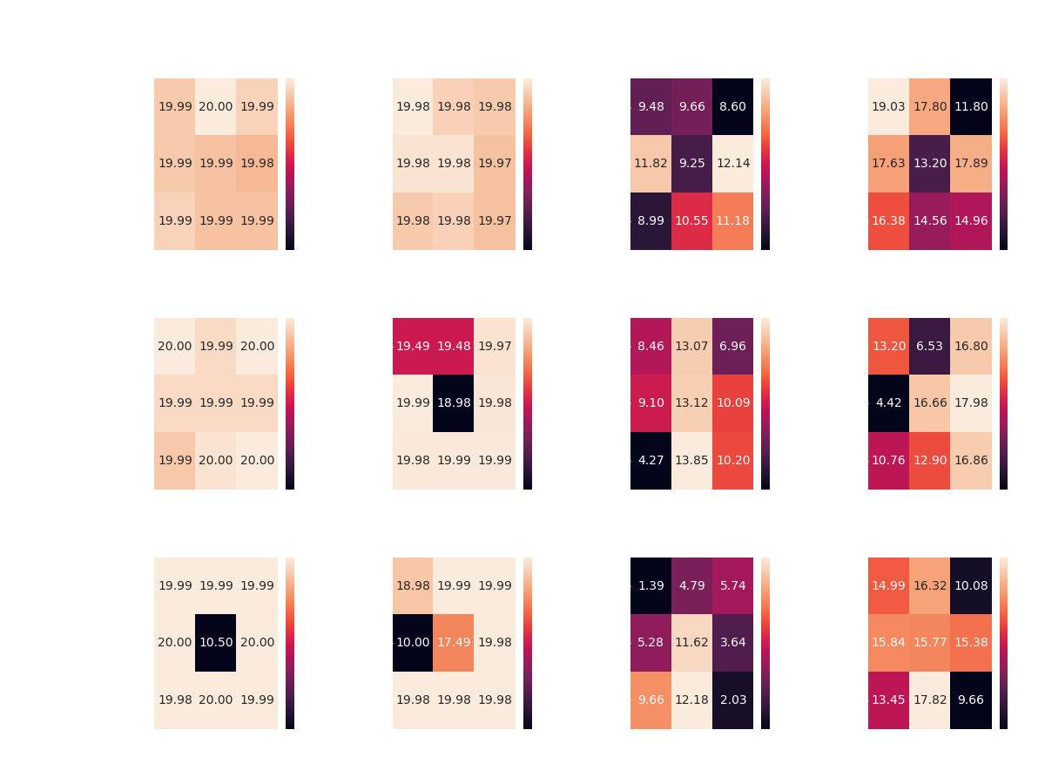
choosing optimal parameters
DDQN agent vs. Single Action Agent
Board of 10x10
Max reward of 20, by the fixed parameter of “Zombies per Game”

Slide 35
choosing optimal parameters
DDQN vs. all Simple Agents – board of 10x10:

Slide 36
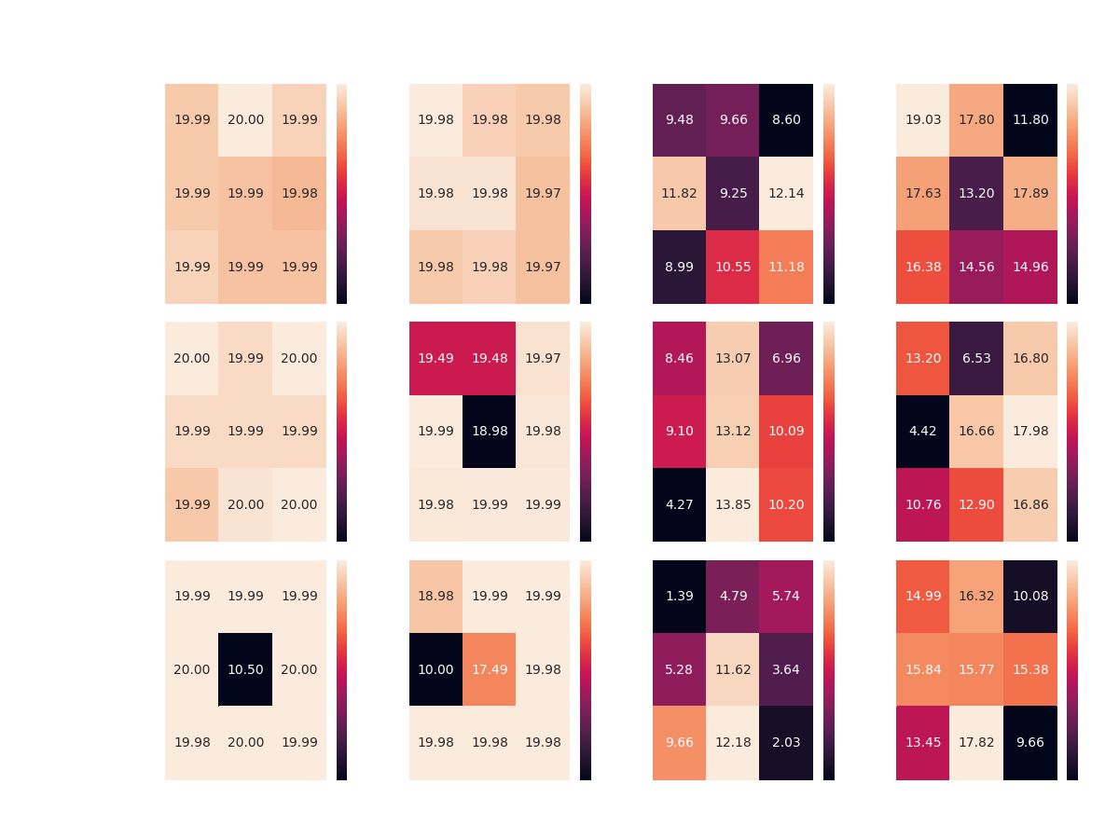

Slide 37
Results Discussion
Overall, it seems that the DDQN agent manages to overcome its competitors in most of the scenarios:
Achieving optimal reward competing Single and Double Action Agents with most of the configurations, on top all boards
Achieving 17+ average reward competing the Gaussian Agent on all boards, without achieving optimal reward in any scenario
However, the DDQN agent seems to encounter difficulties when faced with the Uniform Agent – managing to achieve average reward of 12-14

Slide 38
Results Discussion
While Competing against both the Random Agents, the DDQN Agent gets approximately same average reward over all three boards
Perhaps more learning episodes would make a change here?
Keep in mind that the highest reward against the Uniform Agent as light player is 15 – calculated by an agent which picks the best action exclusively (places zombies at the first row)
To settle the issue, I ran multiple scenarios of the same configuration, DDQN Agent vs. Uniform Agent, this time with 1800 learning episodes and 200 test episodes – all cases yield to the same average test reward of around 12

Slide 39
DDQN plays zombie - Best configurations*
Board size | Competitor | Memory Size | Target Update | Average Test Reward
10x10 | Single Action | 3000 | 750 | 20
 | Double Action | 3000 | 500 | 19.98
 | Uniform | 4000 | 1000 | 12.14
 | Gaussian | 3000 | 500 | 19.03
20x20 | Single Action | 3000 | 500 | 20
 | Double Action | 4000 | 500 | 19.99
 | Uniform | 5000 | 750 | 13.85
 | Gaussian | 4000 | 1000 | 17.98
30x30 | Single Action | 5000 | 750 | 20
 | Double Action | 3000 | 1000 | 19.99
 | Uniform | 5000 | 750 | 12.18
 | Gaussian | 5000 | 750 | 17.82

Slide 40
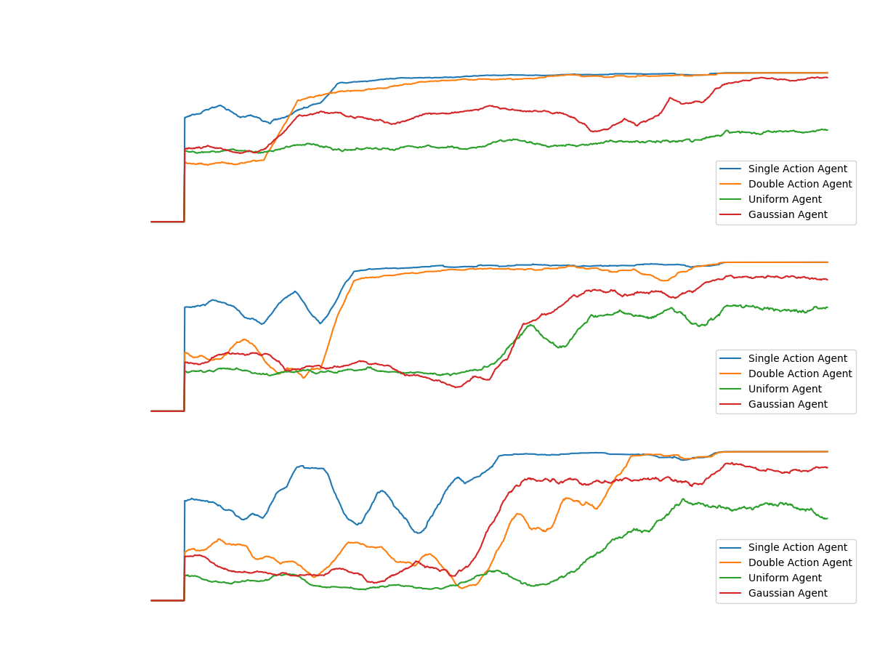
Notes:
note that in the case where the algorithm plays the zombie, the reward is positive
In general it can be noticed that there is learning against all the agents in all the games.
There is absolute success (convergence to optimal policy) against the constant agents
On the other hand, in games against the random agents, there is partial success but a significant upward trend in almost all cases.
In all cases except against the random agent in the game in the smallest board.
Because at this stage we have not examined the results in relation to any optimal method, we can not say if these are the best results the agent could achieve, but these are good and satisfactory results - there is general learning in all board sizes and against all agents

Slide 41
DDQN as the light player
Goal – Maximize Total Reward – Minimize Zombies survive

Slide 42
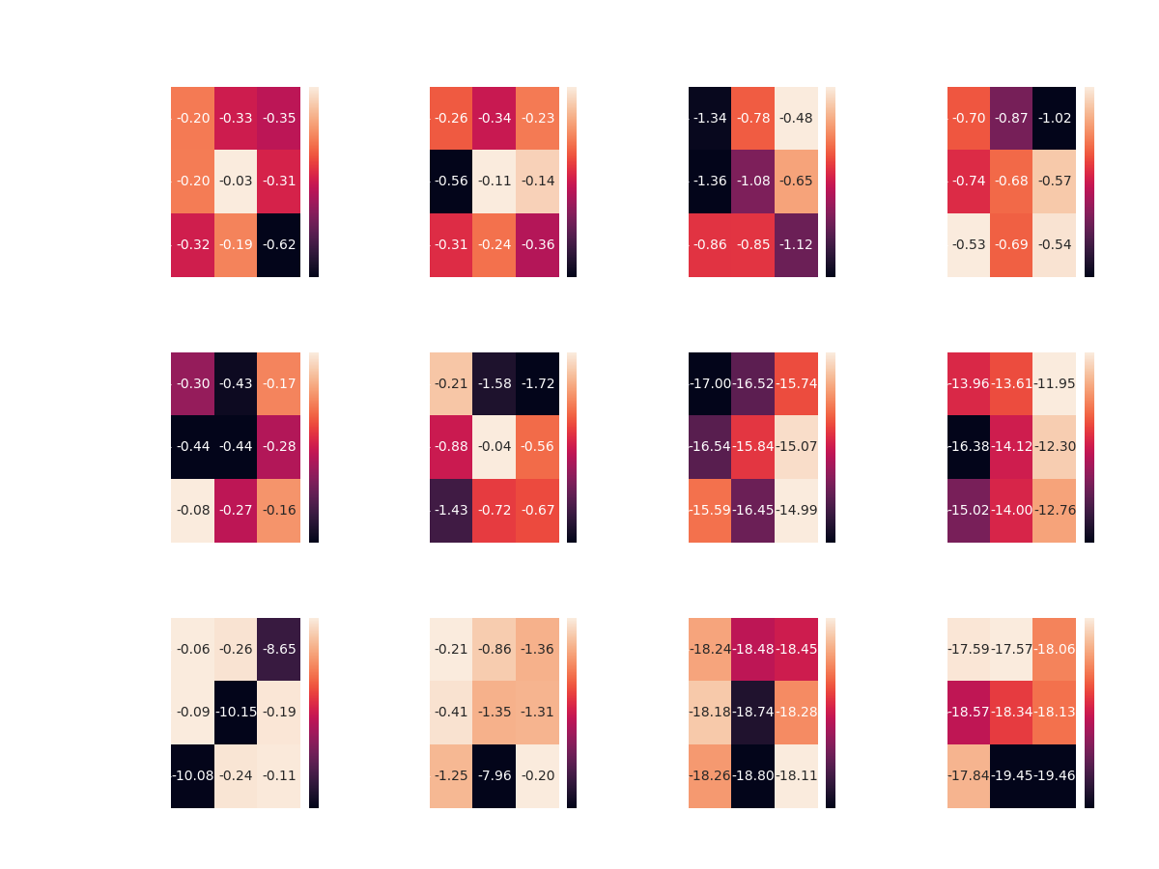
DDQN agent vs. Single action agent
Board of 10x10
Get negative rewards as the opposite of Zombie Player

Slide 43
DDQN vs. all – board of 10x10

Slide 44
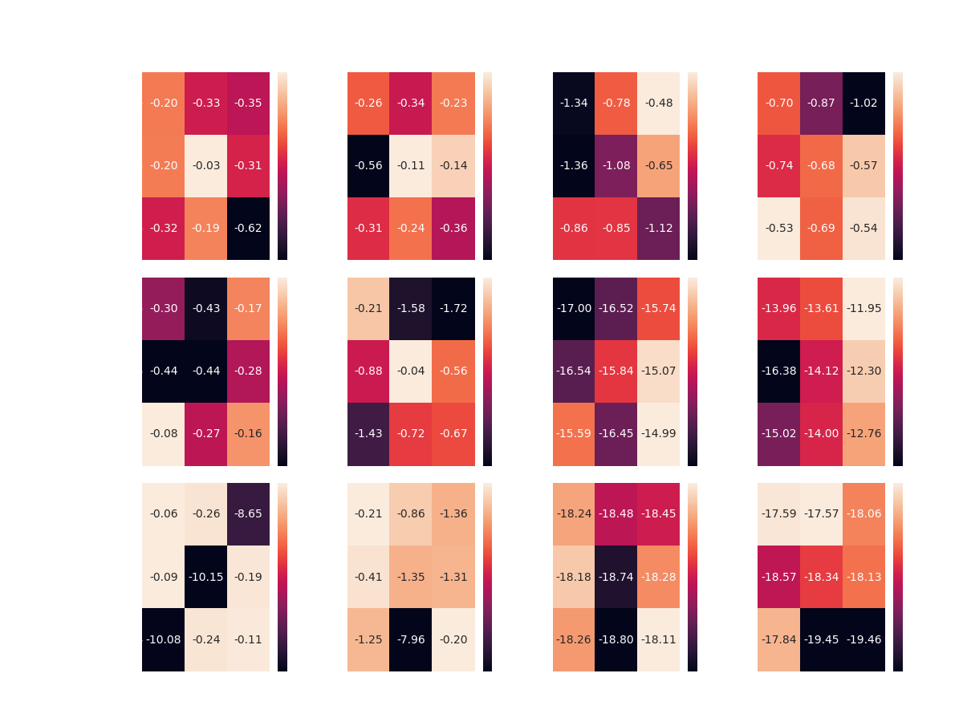

Slide 45
Results Discussion
This time the DDQN Agent managed to achieve partial success.
Over all boards, the DDQN Agent seems to overcome the two Constant Agents
With some preference of the [750, 4000] configuration in half of the cases
However, competing the Random Agents didn’t lead to same success
The DDQN Agent was able to reach optimality only in the case of the smallest board
This time, without any preference of any specific configuration

Slide 46
DDQN plays light - Best configurations
 | Competitor | Memory size | Target update | Average Test Reward
Board 10x10 | Single Action | 4000 | 750 | 0.03-
 | Double Action | 4000 | 750 | 0.11-
 | Uniform | 3000 | 1000 | 0.48-
 | Gaussian | 5000 | 500 | 0.53-
Board 20x20 | Single Action | 5000 | 500 | 0.08-
 | Double Action | 4000 | 750 | 0.04-
 | Uniform | 5000 | 1000 | 14.99-
 | Gaussian | 3000 | 1000 | 11.94-
Board 30x30 | Single Action | 3000 | 500 | 0.06-
 | Double Action | 5000 | 1000 | 0.2-
 | Uniform | 5000 | 1000 | 18.11-
 | Gaussian | 3000 | 750 | 17.57-

Slide 47
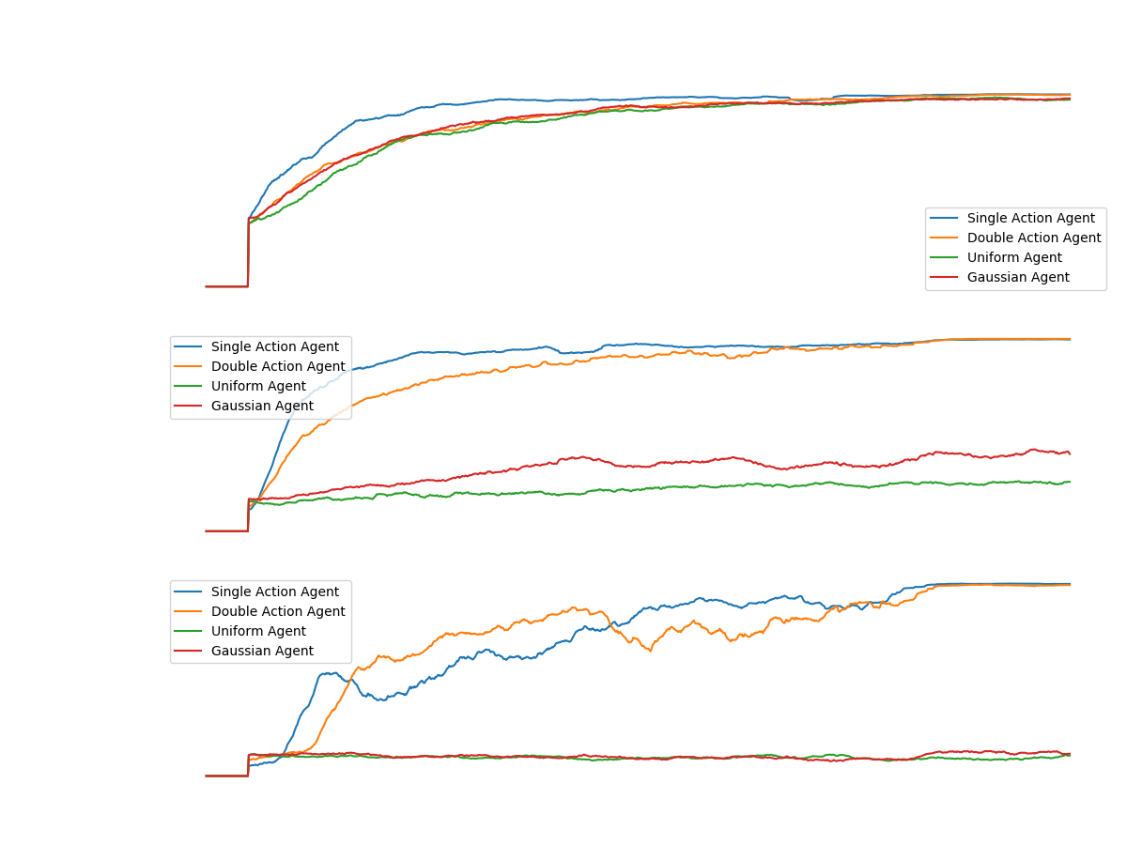
Notes:
note that in the case where the algorithm plays the zombie, the reward is negative
We can see a beautiful convergence to optimal policy against all agents on a 10x10 board.
However, when looking at the success of the light player as the DDQN agent in larger board sizes, one can see controversial success.
There is a convergence in all cases in the game against the constant agents.
But, if we look at the game against the random agents, we can see a relatively upward trend in the game against the middle Gaussian agent.
And in the rest of the games: A complete failure - there is not even a spark of convergence.

Slide 48
What’s next?
Implement the following algorithms:
Monte-Carlo-Tree-Search
Alpha-Zero
Evaluate the above algorithms, as Learning Agents competing the Simple Agents
Compete all Learning Agents with each other
With best configurations from last stage

Slide 49

Thanks!
Any Questions?

